Slide 1




Fixing Distributed Systems Fail
Jimmy Bogard
@jbogard
github.com/jbogard
jimmybogard.com

Slide 2
6 little lines of code

Slide 3
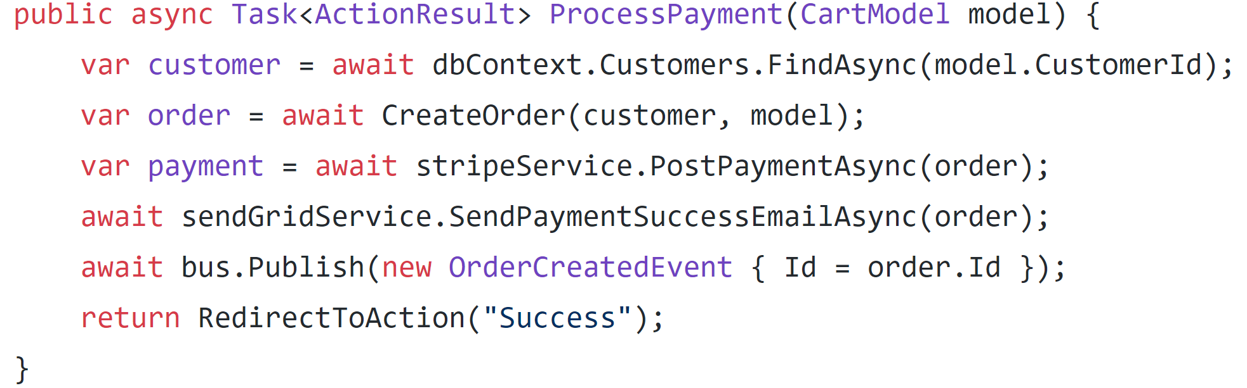

Slide 4
Find Customer from DB

Slide 5
Find Customer from DB
Create Order from cart and customer details

Slide 6
Find Customer from DB
Create Order from cart and customer details
Post payment to Stripe

Slide 7
Find Customer from DB
Create Order from cart and customer details
Post payment to Stripe
Send thank you email via SendGrid

Slide 8
Find Customer from DB
Create Order from cart and customer details
Post payment to Stripe
Send thank you email via SendGrid
Publish a message to RabbitMQ

Slide 9
Find Customer from DB
Create Order from cart and customer details
Post payment to Stripe
Send thank you email via SendGrid
Publish a message to RabbitMQ
Redirect customer to “thank you” page

Slide 10
dbContext.SaveChanges();
Find Customer from DB
Create Order from cart and customer details
Post payment to Stripe
Send thank you email via SendGrid
Publish a message to RabbitMQ
Redirect customer to “thank you” page

Slide 11
Failure is ALWAYS an option

Slide 12
Txn
Stripe
2.
API
POST
3.
1.
SendGrid
DB
4.
RabbitMQ
5.

Slide 13
Txn
Stripe
2.
API
POST
3.
1.
SendGrid
DB
4.
RabbitMQ
5.

Slide 14
Txn
Stripe
2.
API
POST
3.
1.
SendGrid
DB
4.
Transaction rolls back, error shown to user, system is consistent
RabbitMQ
5.

Slide 15
Txn
Stripe
2.
API
POST
3.
1.
SendGrid
DB
4.
RabbitMQ
5.

Slide 16
Txn
Stripe
2.
API
POST
3.
1.
SendGrid
DB
4.
No money posts, transaction rolls back, system is consistent
RabbitMQ
5.

Slide 17
Txn
Stripe
2.
API
POST
3.
1.
SendGrid
DB
4.
RabbitMQ
5.

Slide 18
Txn
Stripe
2.
API
POST
3.
1.
SendGrid
DB
4.
Customer is charged but transaction rolls back, system is inconsistent!
RabbitMQ
5.

Slide 19
Txn
Stripe
2.
API
POST
3.
1.
SendGrid
DB
4.
RabbitMQ
5.

Slide 20
Txn
Stripe
2.
API
POST
3.
1.
SendGrid
DB
4.
Customer is charged and notified but transaction rolls back. System is inconsistent
RabbitMQ
5.

Slide 21
Txn
Stripe
2.
API
POST
3.
1.
SendGrid
DB
4.
RabbitMQ
5.

Slide 22
Txn
Stripe
2.
API
POST
3.
1.
SendGrid
Customer is charged and notified and downstream systems notified but transaction rolls back. System is f@&ked
DB
4.
RabbitMQ
5.

Slide 23
What do?

Slide 24
¯\_(ツ)_/¯ is probably not good for business

Slide 25
Txn
Stripe
2.
API
POST
3.
1.
SendGrid
DB
4.
RabbitMQ
5.

Slide 26
Txn
Stripe
2.
API
POST
3.
1.
SendGrid
DB
4.
RabbitMQ
5.

Slide 27
We can’t put the world into a transaction

Slide 28
Assume failures

Slide 29
Plan for the worst

Slide 30
4 options for dealing with failures between two systems
Gregor Hohpe – “Your Coffee Shop Doesn’t Use Two-Phase Commit”
http://bit.ly/2uCevAB

Slide 31
✓
Resource A
Ignore
Action
Resource B

Slide 32
✓
Resource A
Ignore
Action
Resource B
Retry
✓
Resource A
Action
Resource B
(Retry)

Slide 33
✓
Resource A
(Undo)
Resource A
Ignore
Undo
✓
Action
Action
Resource B
Resource B
Retry
✓
Resource A
Action
Resource B
(Retry)

Slide 34
✓
Resource A
(Undo)
Resource A
Ignore
Undo
✓
Action
Action
Resource B
Resource B
Prepare
Retry
✓
Resource A
Coordinate
Resource A
Coordinator
Action
Feedback
Resource B
Resource B
(Retry)
Commit

Slide 35
The Master Plan

Slide 36
For each external resource, examine possibilities and pick best option based on business requirements

Slide 37
First up: Stripe

Slide 39
Option 1: Ignore

Slide 40
Probably don’t want to ignore a failed payment

Slide 41
Option 2: Retry

Slide 42
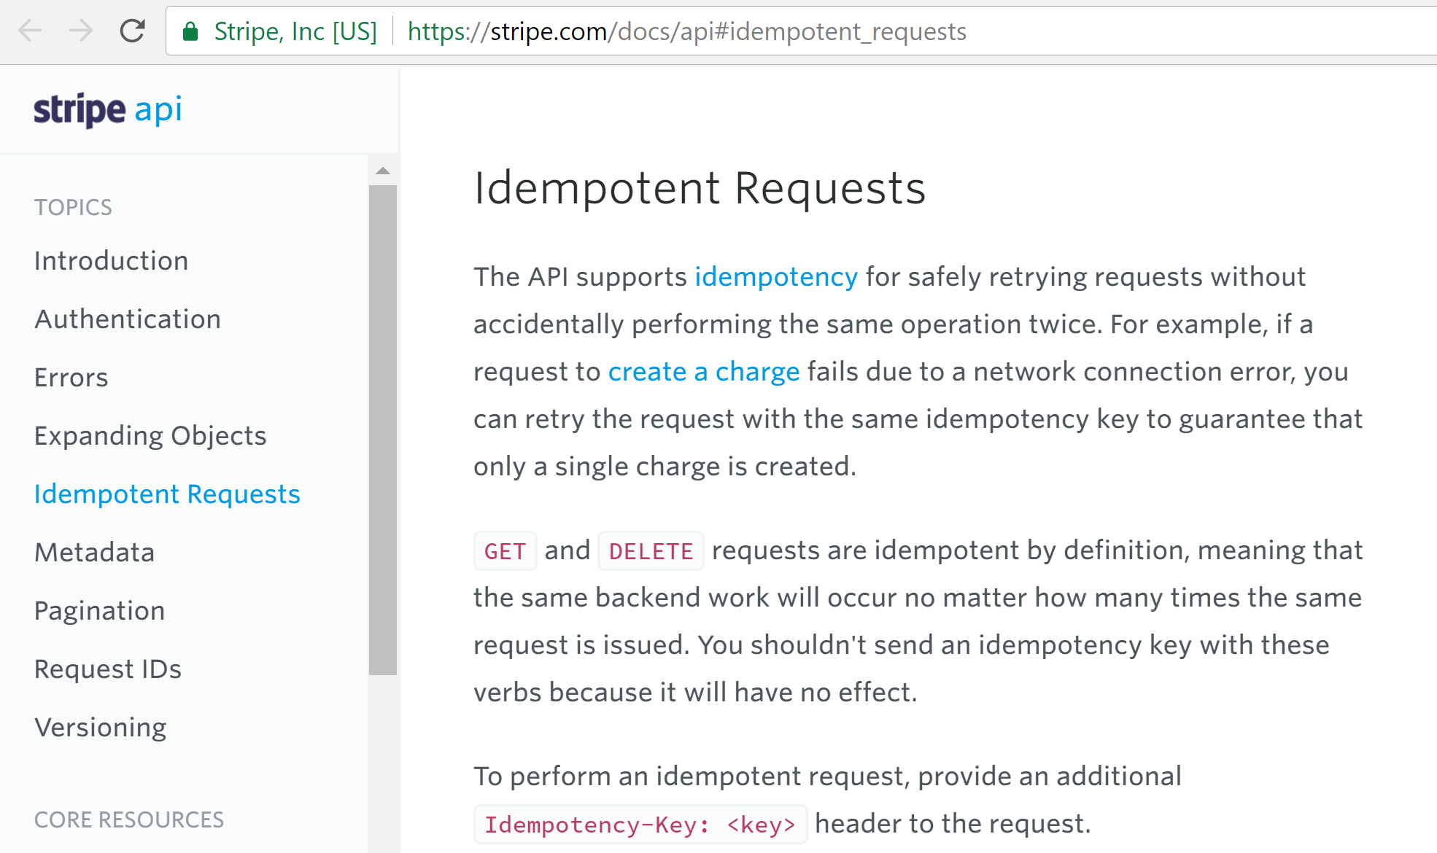

Slide 44
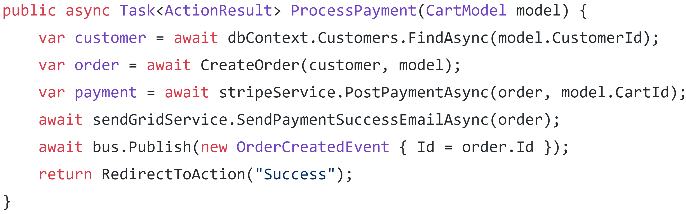

Slide 46
Option 3: Undo

Slide 47
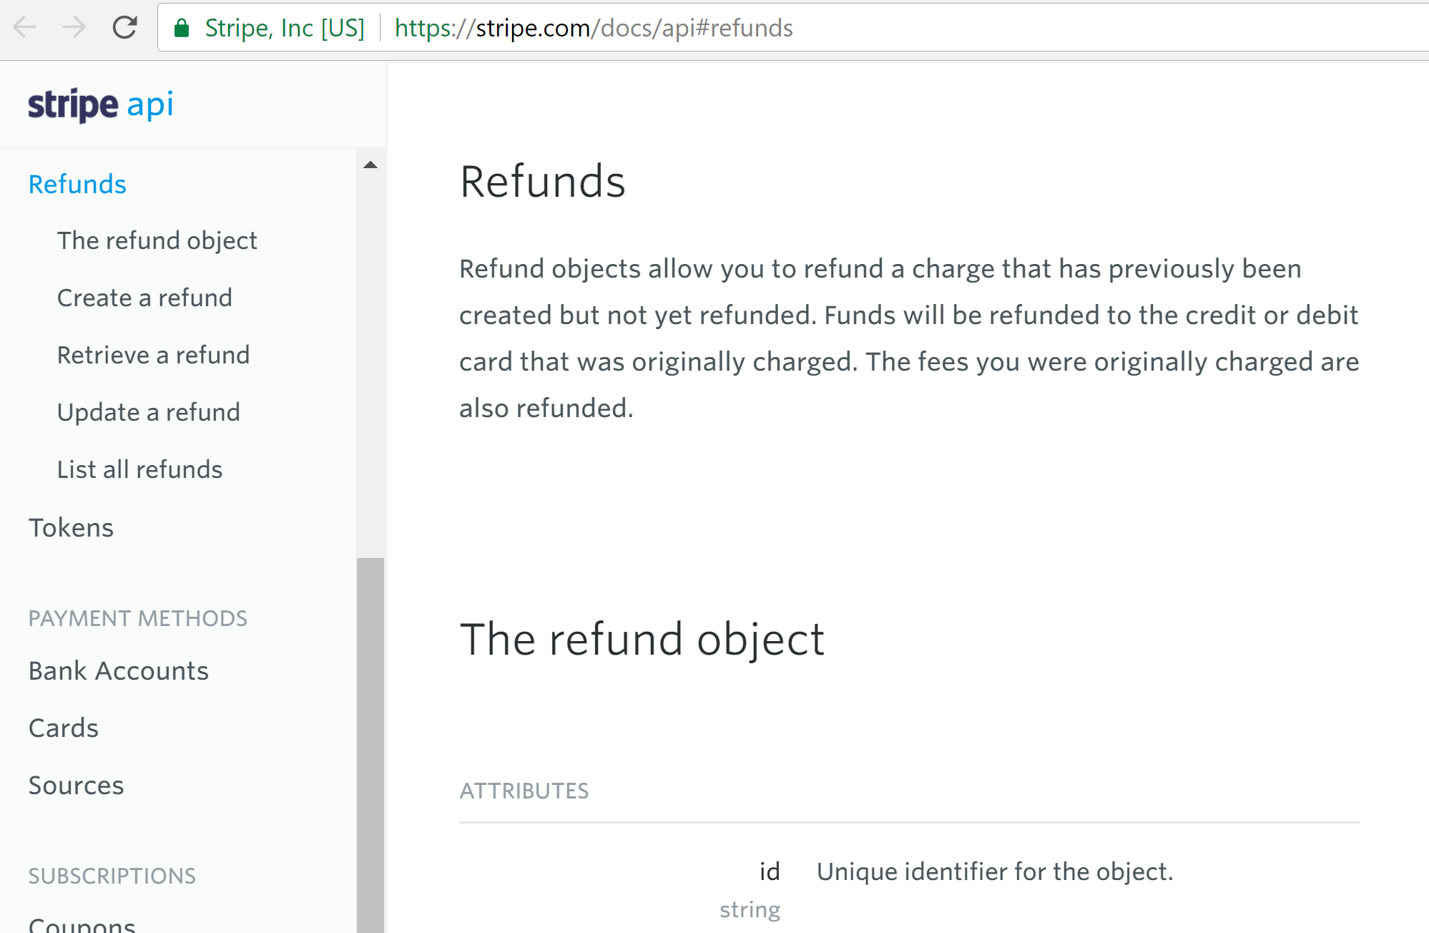

Slide 48
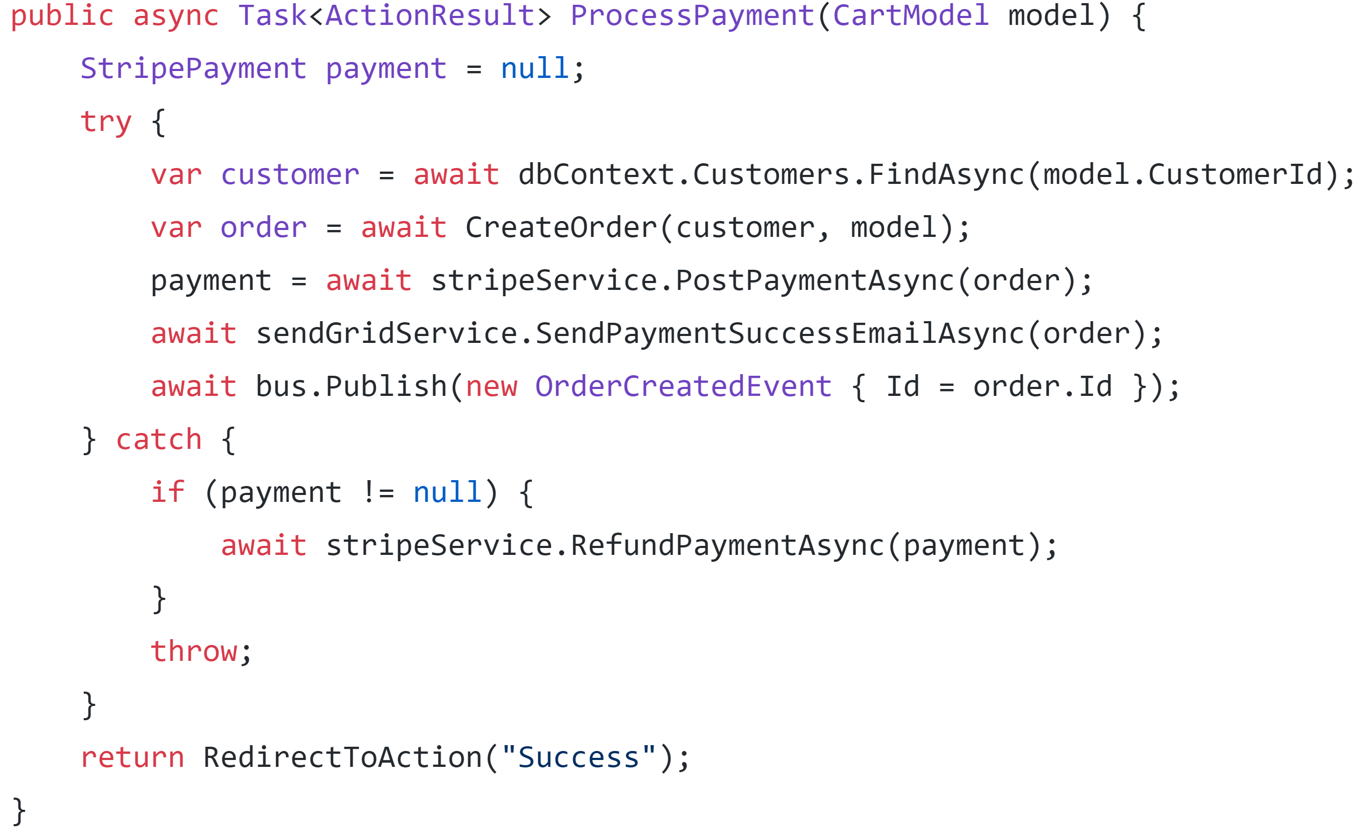

Slide 50
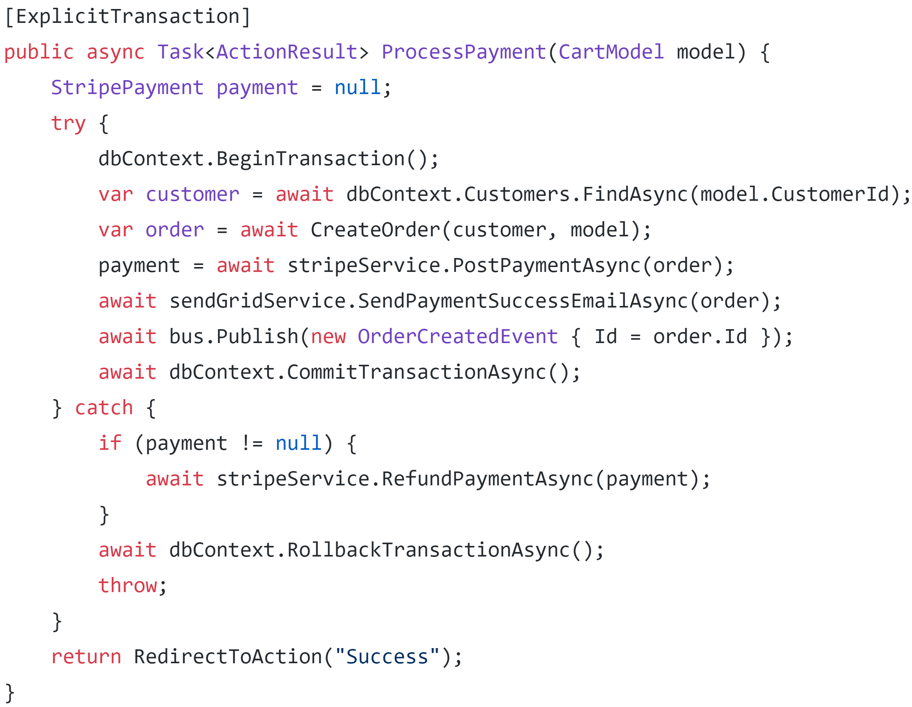

Slide 52
Option 4: Coordinate

Slide 53
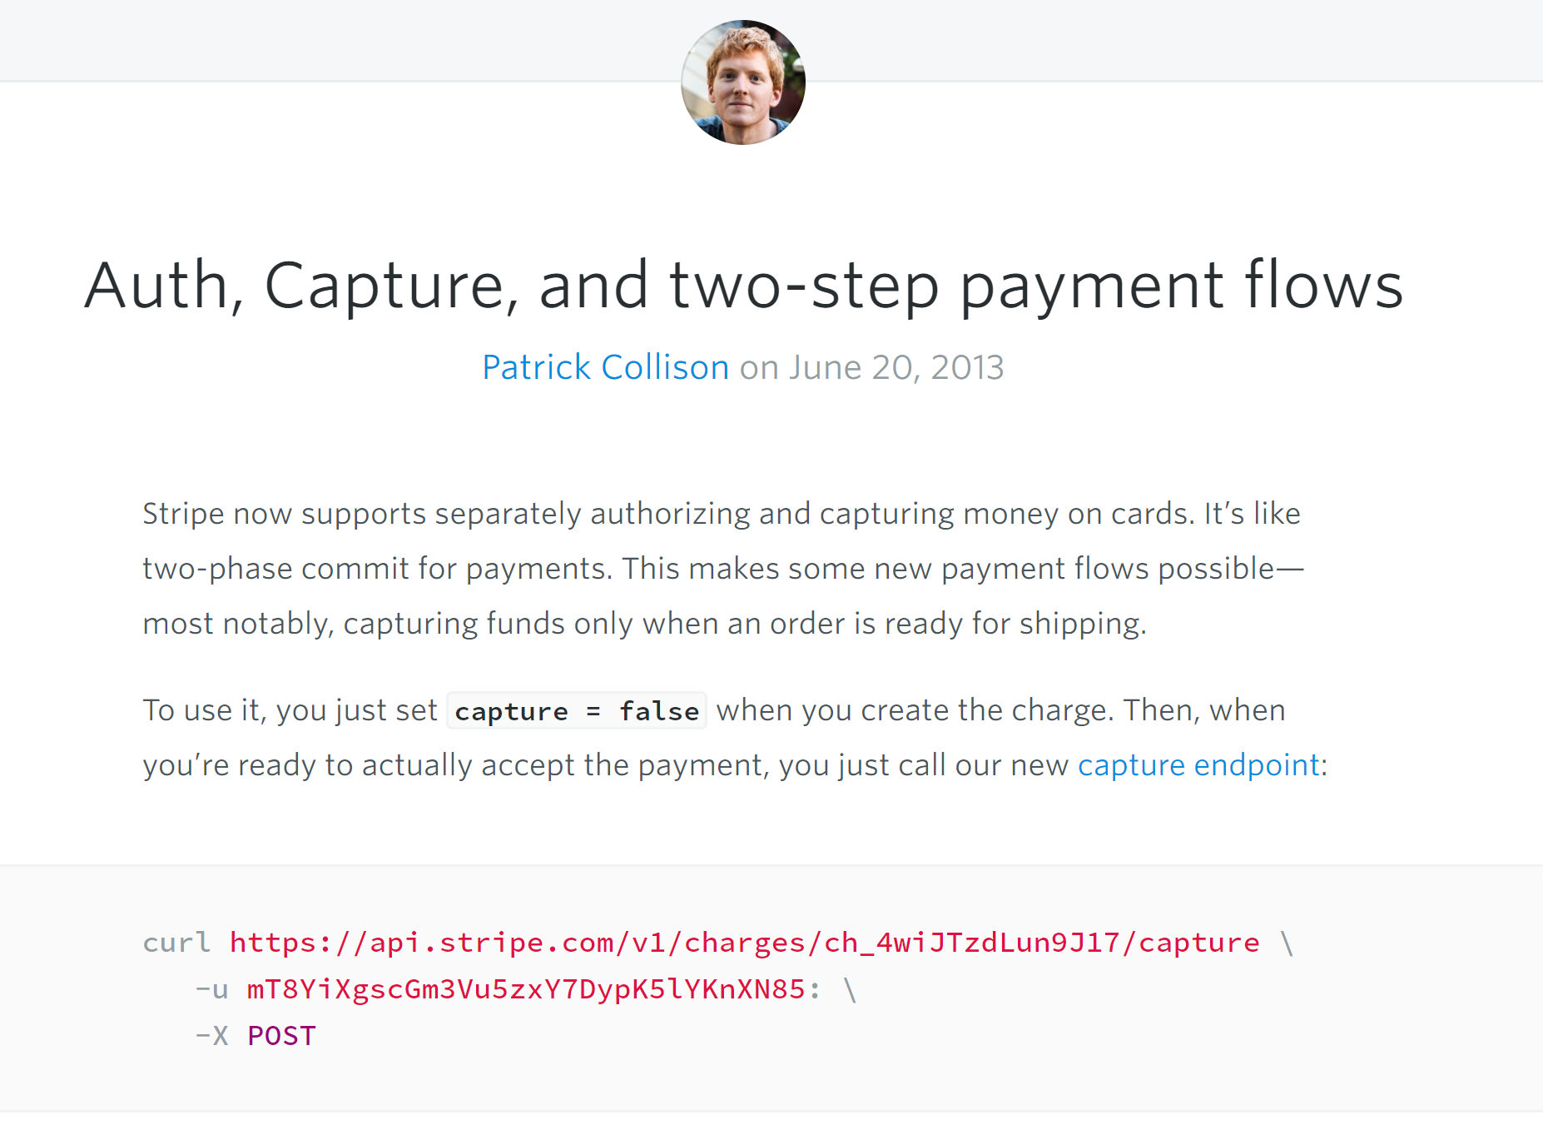

Slide 54
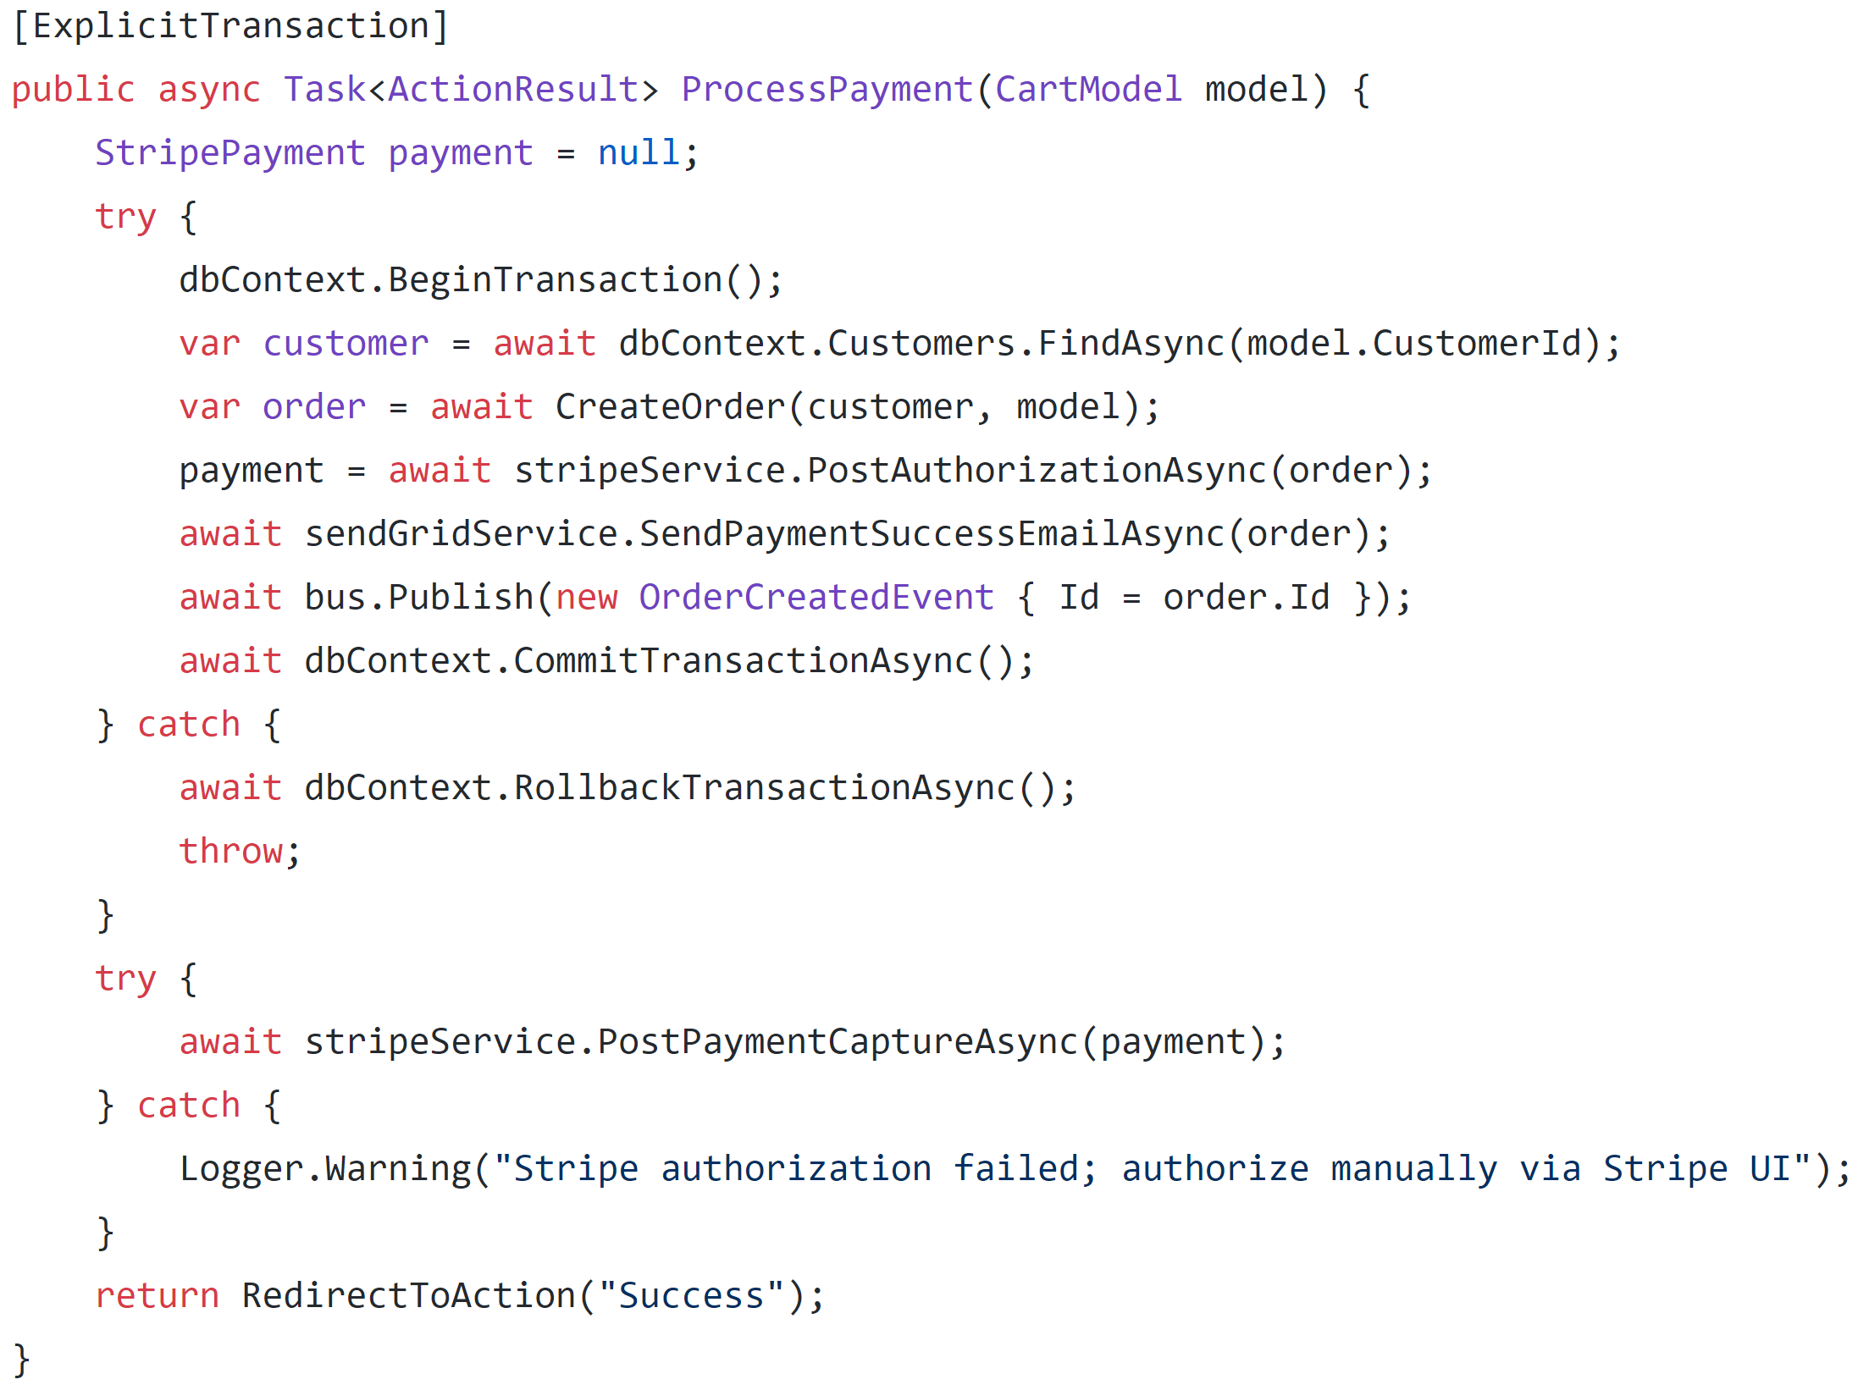

Slide 55
Authorize

Slide 56
Authorize
Capture

Slide 57
Next up: SendGrid

Slide 58
Option 1: Ignore

Slide 59
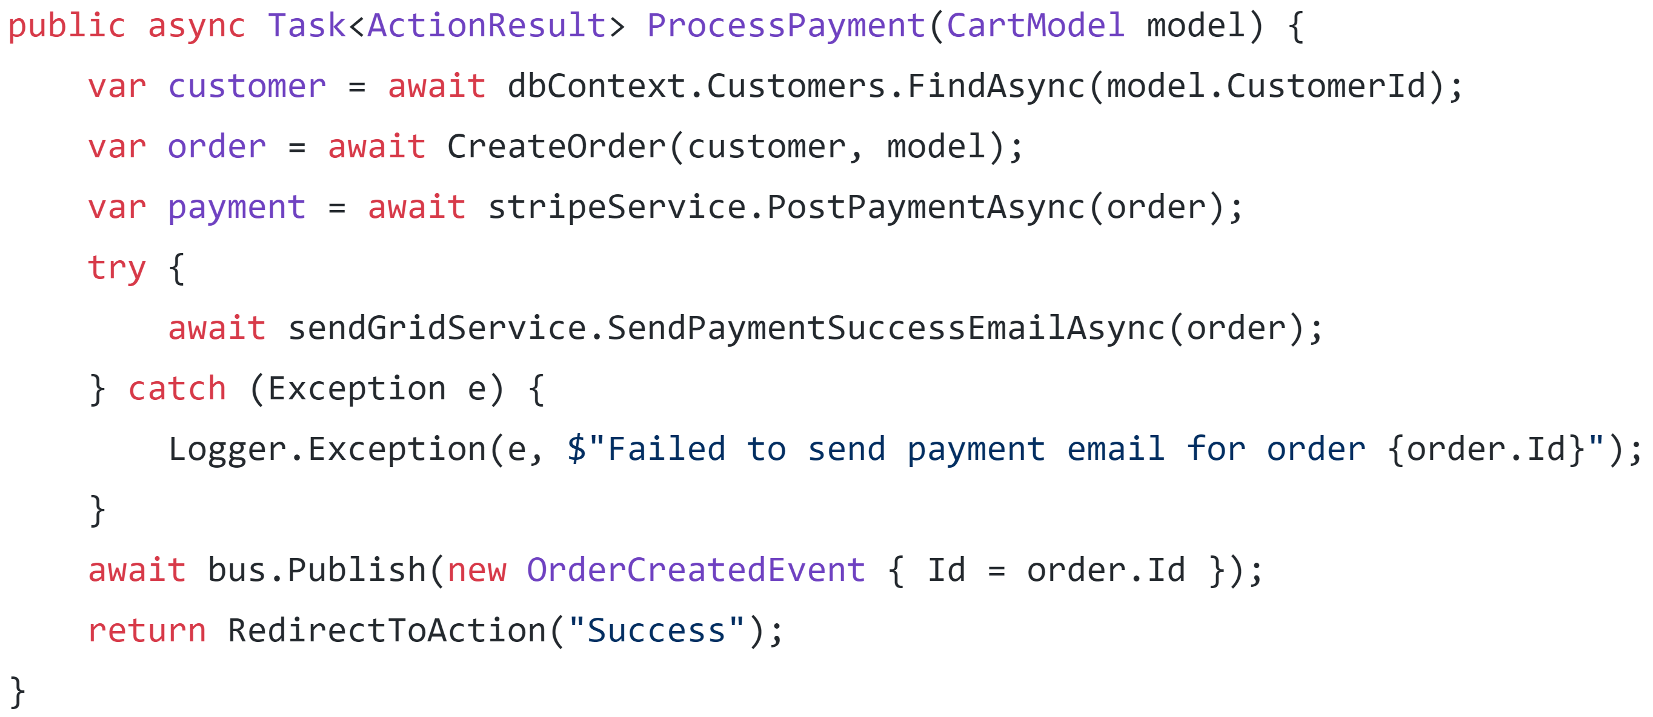

Slide 61
Option 2: Retry

Slide 62
Not unless we want duplicate emails

Slide 63
Option 3: Undo

Slide 64
We can’t un-send emails

Slide 65
Apologize?

Slide 66
Option 4: Coordinate

Slide 67
???????

Slide 68
Finally: RabbitMQ

Slide 69
Option 1: Ignore

Slide 70
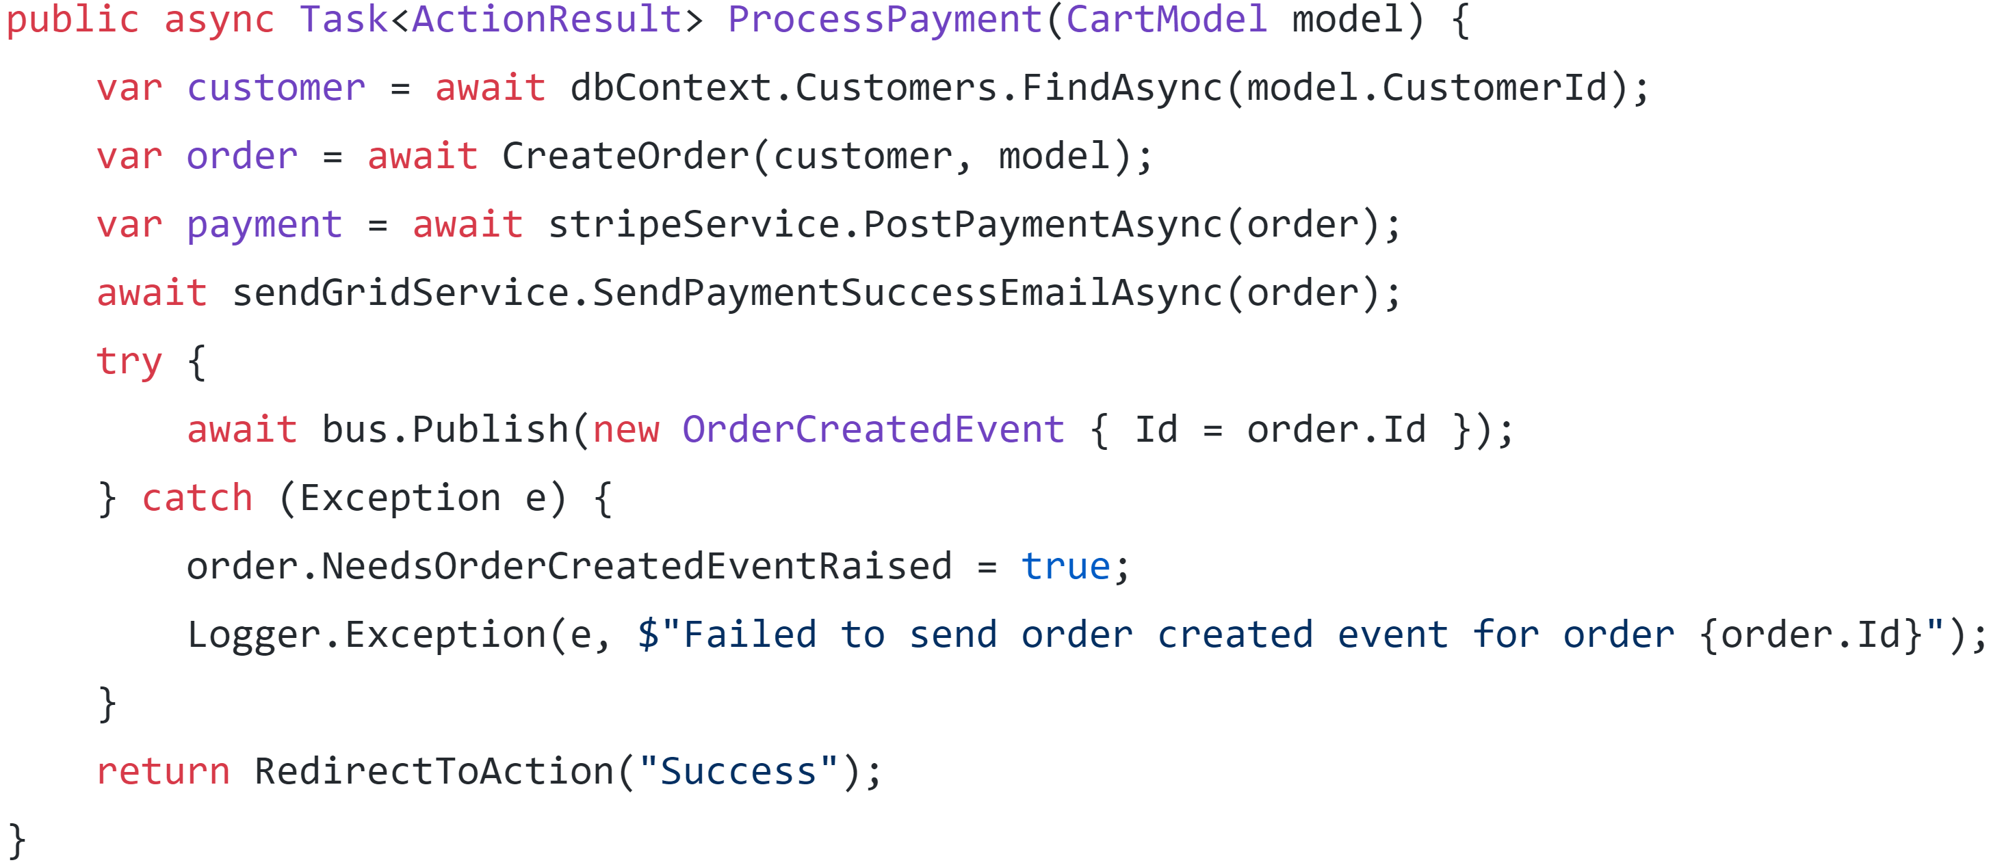

Slide 72
Option 2: Retry

Slide 73
Retry
✓
Resource A
Action
RabbitMQ
(Retry)

Slide 74
Consumer A
Retry
✓
Resource A
Consumer B
Action
RabbitMQ
(Retry)
Consumer C

Slide 75
Option 3: Undo

Slide 76
Can’t un-send a message

Slide 77
Compensating message is...weird

Slide 78
Option 4: Coordinate

Slide 79
 | Ignore | Retry | Undo | Coordinate
Stripe | X | ✓ | ✓ | ✓
SendGrid | ✓ | X | X | X
RabbitMQ | ✓ | X | X | X

Slide 80
Taking a step back

Slide 81
Can we avoid exceptions by breaking the process coupling?

Slide 82
Txn
Stripe
2.
API
POST
3.
1.
SendGrid
DB
4.
RabbitMQ
5.

Slide 83
Txn
Stripe
?
2.
API
POST
3.
1.
SendGrid
DB
4.
RabbitMQ
5.

Slide 84
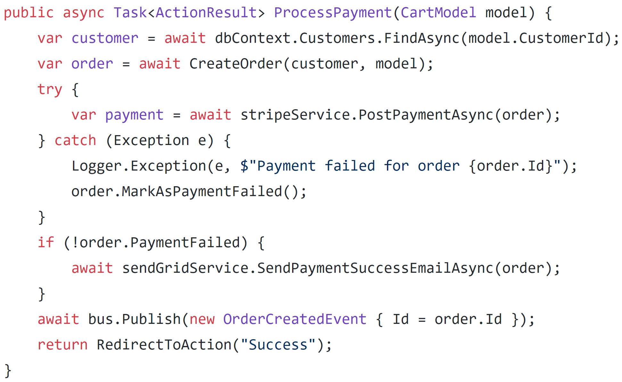

Slide 86
Txn
Stripe
2.
API
POST
3.
1.
SendGrid
?
DB
4.
RabbitMQ
5.

Slide 87
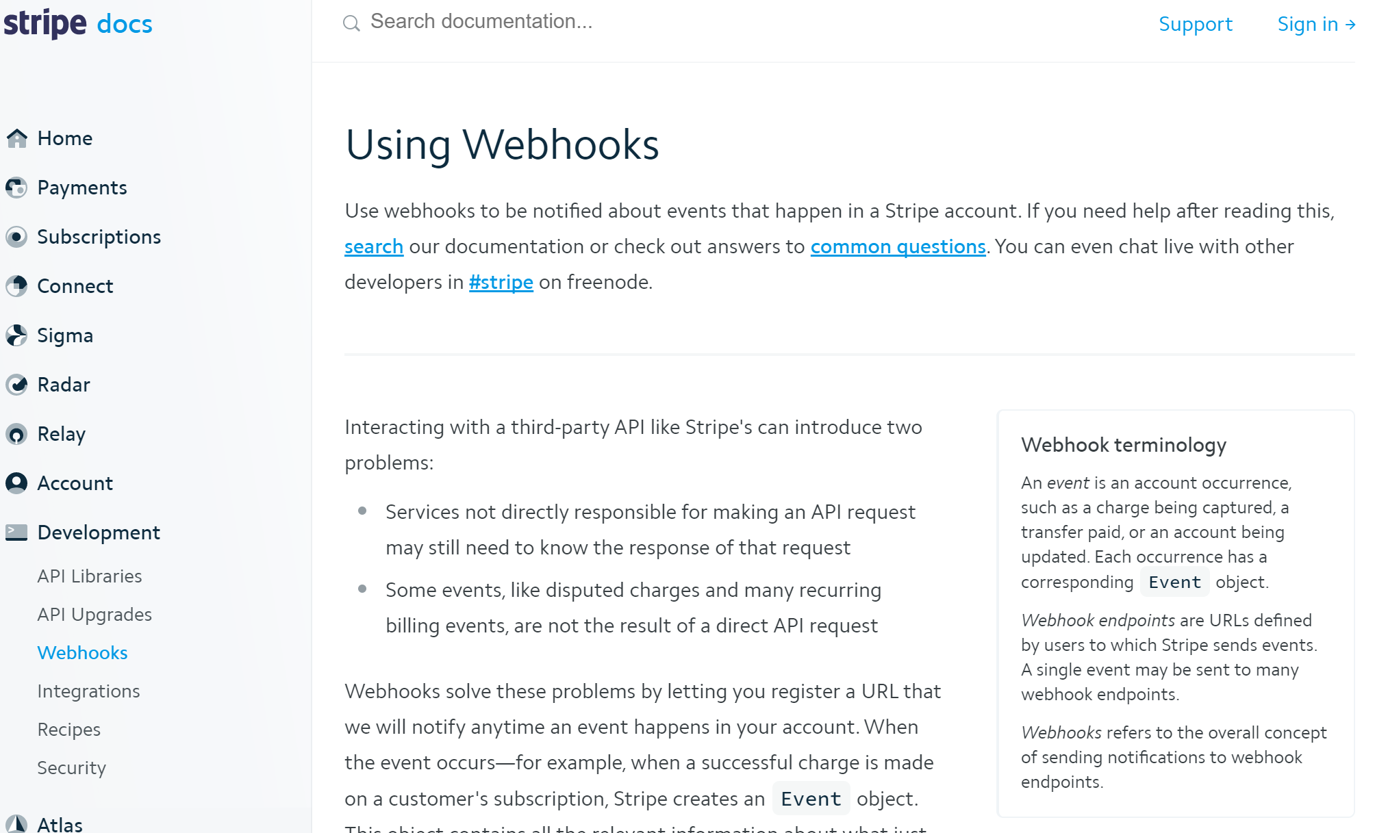

Slide 88
Txn
Stripe
2.
API
POST
3.
1.
SendGrid
DB
4.
RabbitMQ
?
5.

Slide 89
Outbox pattern
Txn
Sender
Broker
Receiver
DB

Slide 90
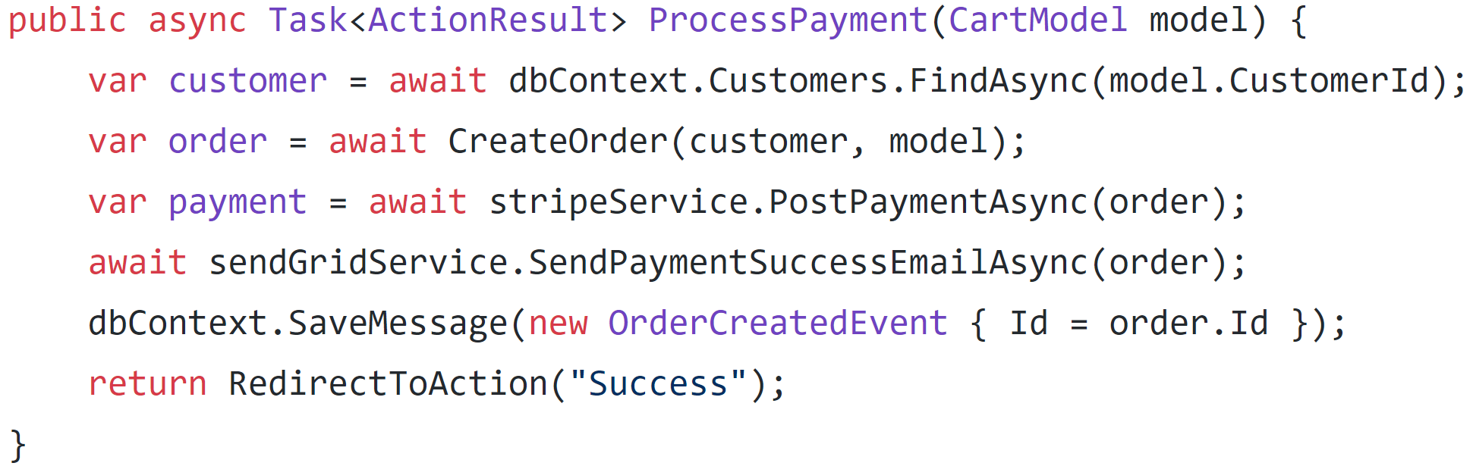
Outbox pattern

Slide 91
Outbox pattern

Slide 92
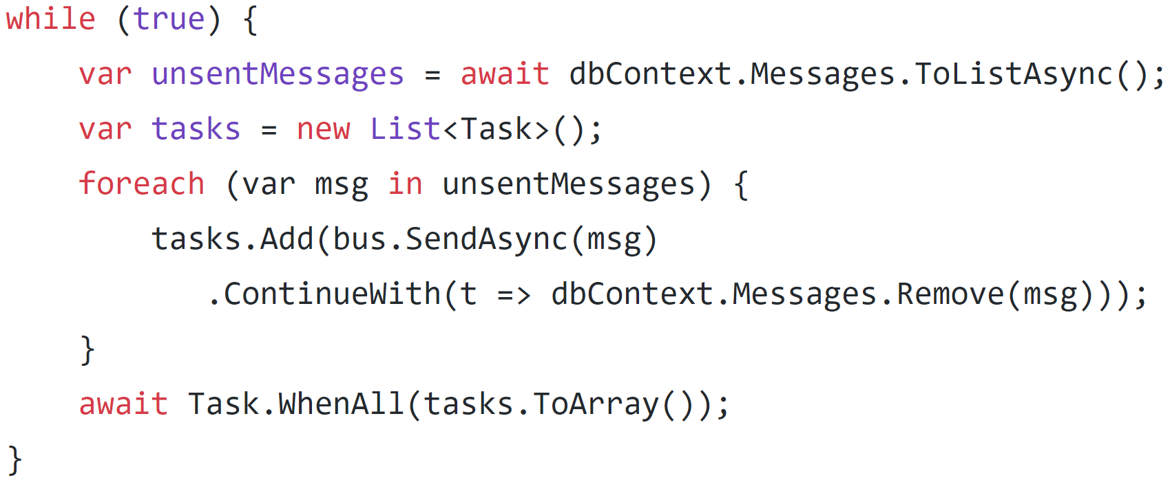
Outbox pattern

Slide 93
Still not there…

Slide 94
Way too much going on in a single button click

Slide 95
Modern ecommerce uses background processing to fulfill orders

Slide 96
Workflow Constraints
Stripe – minimize checkout fallout rate, process offline
Sendgrid – send offline
RabbitMQ – send offline

Slide 97
Starting the workflow

Slide 98
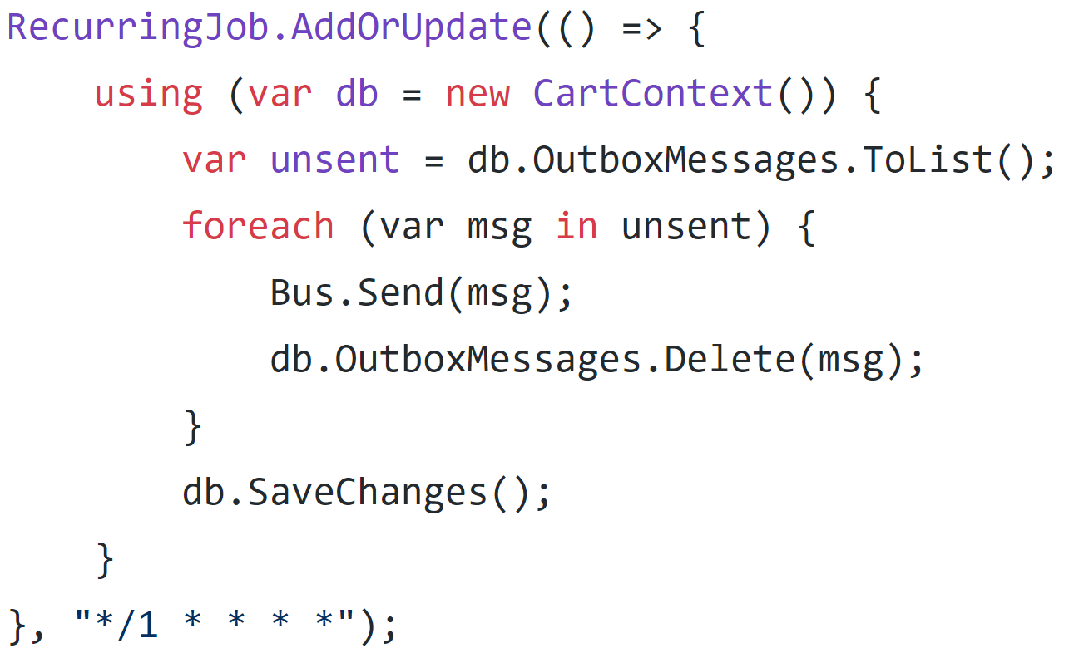
Scheduled jobs with Hangfire

Slide 99
API
Stripe
API
POST
Order Processor
SendGrid
???
DB
Task
RabbitMQ

Slide 100
Routing slip

Slide 101
API
Stripe
API
POST
SendGrid
DB
Task
RabbitMQ

Slide 102

API
Stripe
API
POST
SendGrid
DB
Task
RabbitMQ

Slide 103
Saga pattern

Slide 104
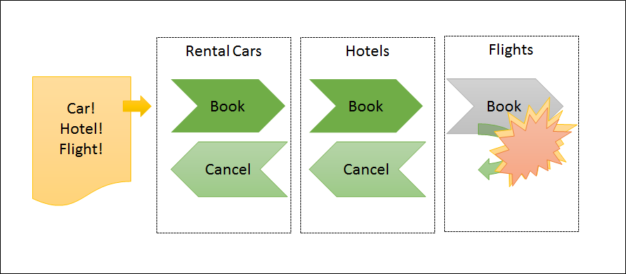

Slide 105
Process manager pattern

Slide 106
API
Stripe
API
POST
Process Manager
SendGrid
DB
Task
RabbitMQ

Slide 107
Orchestration or choreography?
Command-based or event-based?

Slide 108
Process coupling
Stripe – orchestration
Sendgrid – choreography
RabbitMQ - choreography

Slide 109
API
Stripe
API
POST
Process Manager
SendGrid
DB
Task
Service A
Service B

Slide 110
API
Stripe
API
POST
Process Manager
SendGrid
DB
Task
Service A
Service B

Slide 111
API
Stripe
API
Process Manager
SendGrid
DB
Task
Service A
Service B

Slide 112
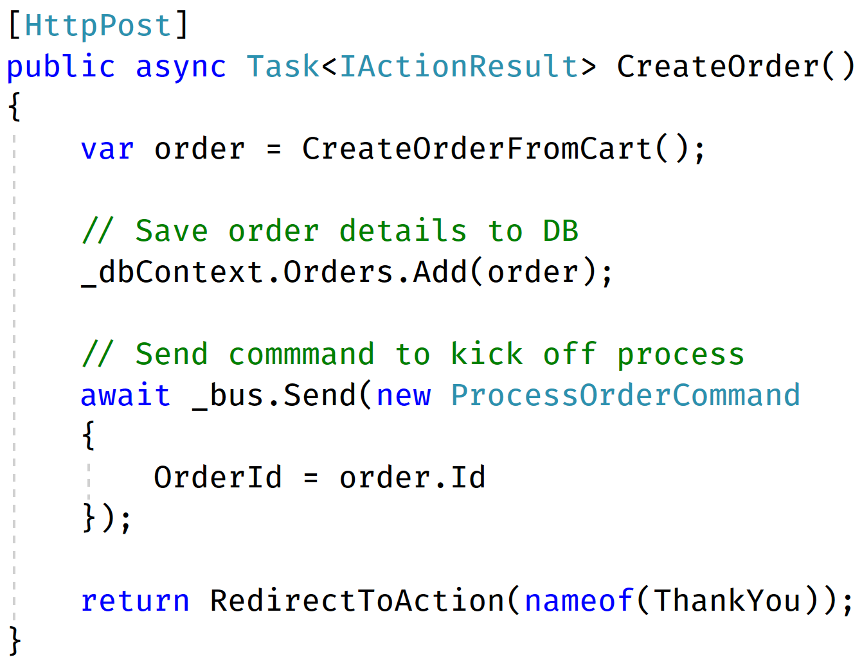

Slide 113
API
Stripe
API
Process Manager
SendGrid
DB
Task
Service A
Service B

Slide 114
API
Stripe
API
Process Manager
SendGrid
DB
Task
Service A
Service B

Slide 115
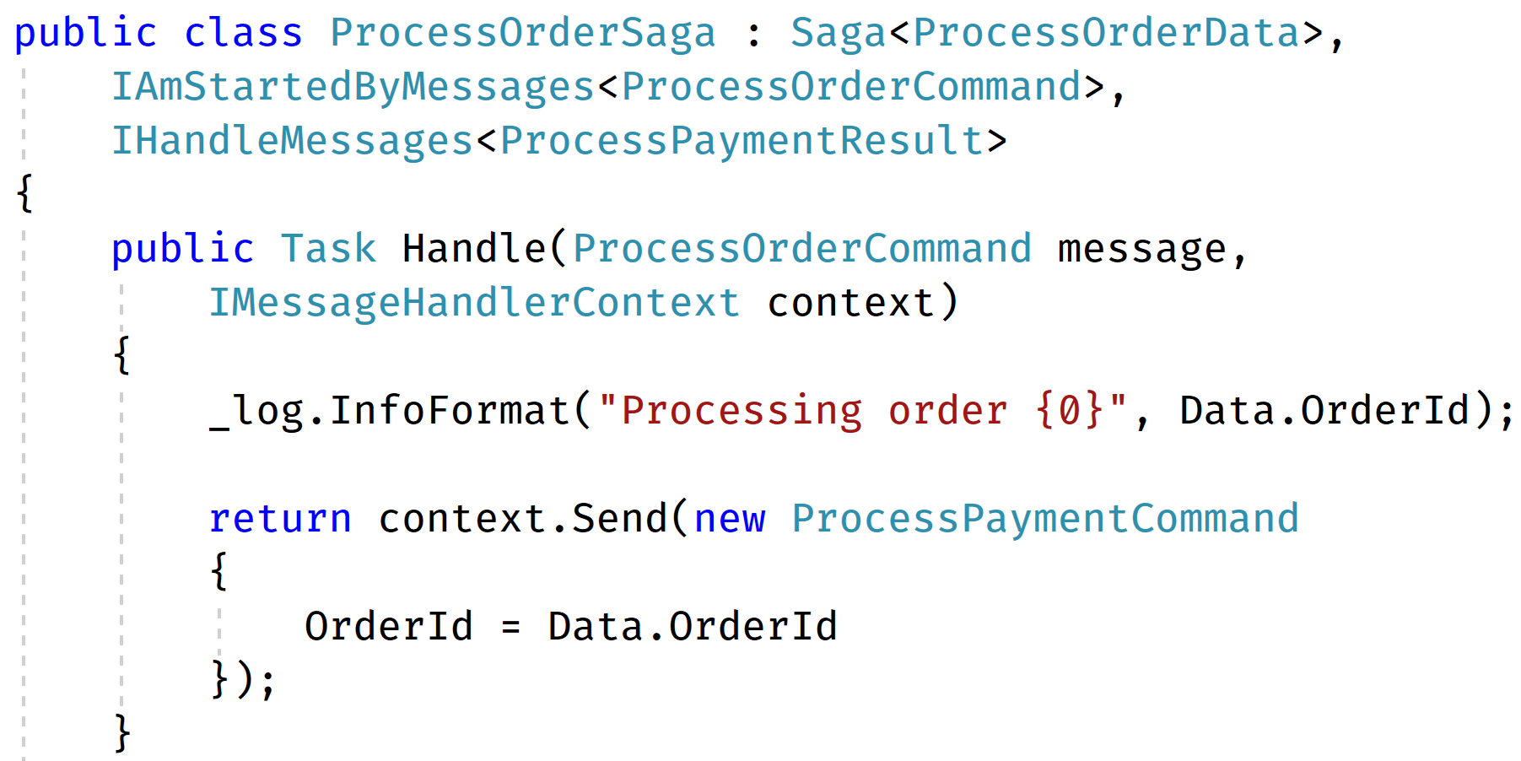

Slide 116
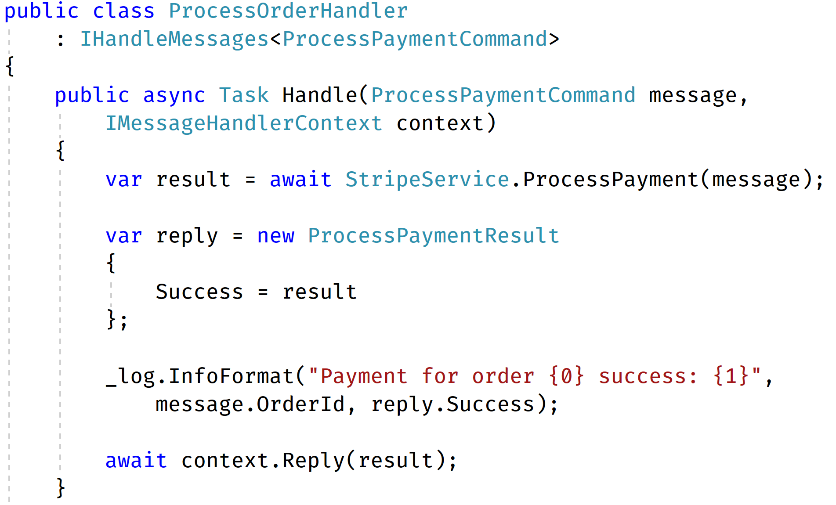

Slide 117
API
Stripe
API
Process Manager
SendGrid
DB
Task
Service A
Service B

Slide 118
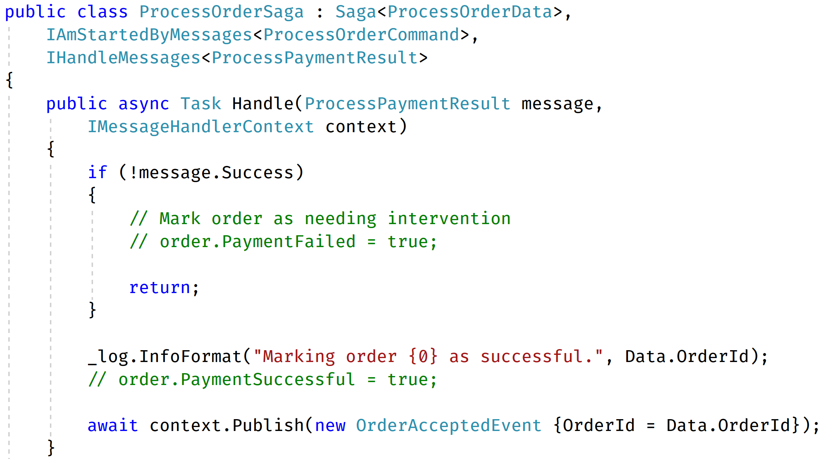

Slide 119
API
Stripe
API
Process Manager
SendGrid
DB
Task
Service A
Service B

Slide 120
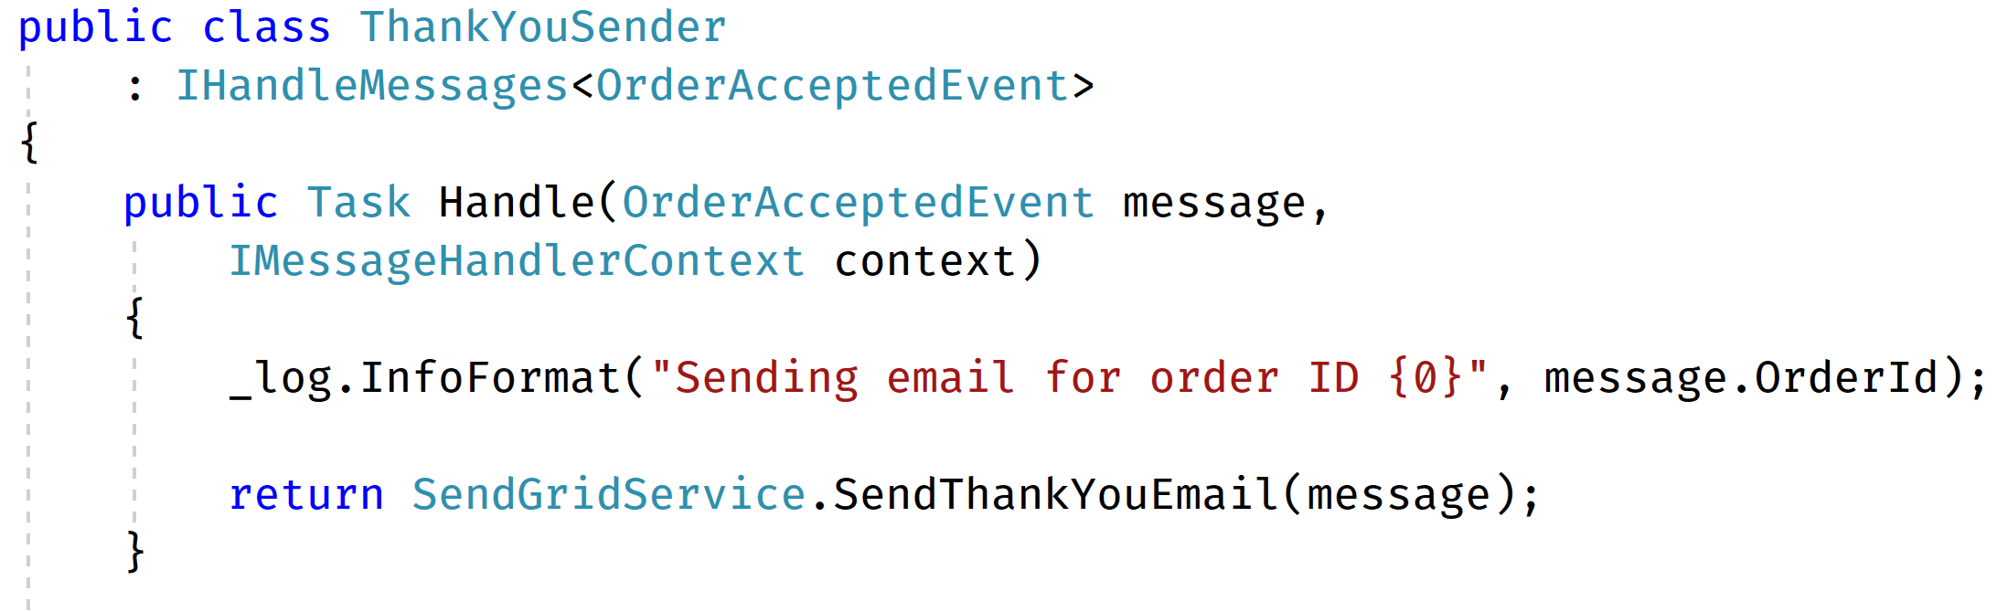

Slide 121
Code Example

Slide 122
API
Stripe
API
Process Manager
SendGrid
DB
Task
Service A
Service B

Slide 123

Fixing Distributed Systems Fail
Jimmy Bogard
@jbogard
github.com/jbogard/presentations
jimmybogard.com
enterpriseintegrationpatterns.com

